Slide 1









Whiteboardmaths.com
7
2
1
5
© 2004 All rights reserved

Slide 2

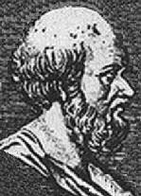
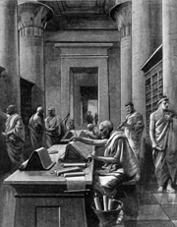
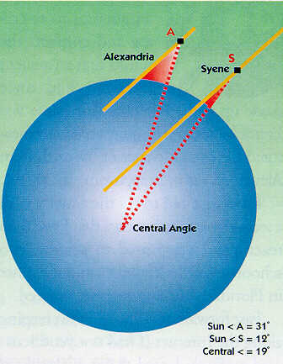
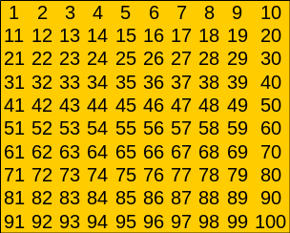
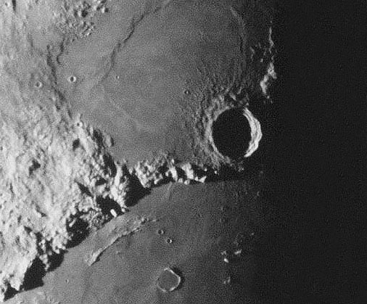
Eratosthenes of Cyrene (275-194 B.C)
Eratosthenes was a prominent Greek scholar who spent his early life in Athens. He was a friend and contemporary of Archimedes and excelled in many areas, notably mathematics, astronomy, geography, history, poetry and athletics. He was a universal genius who was known to his friends as Beta, because he was regarded as the second best in almost all the fields he studied. He eventually went to Alexandria (Egypt) where he became the 3rd librarian at the great university as well as private tutor to the son of Ptolemy III. It was Eratosthenes who suggested a calendar (later adopted by the Romans) of 365 days with an additional day every 4th year. During old age he went blind and ended his life by drinking poison.
He is best remembered today for two notable achievements:
The use of his “Sieve” to isolate prime numbers
His ingenious method for determining the distance around the Earth with a high degree of accuracy.

Slide 3
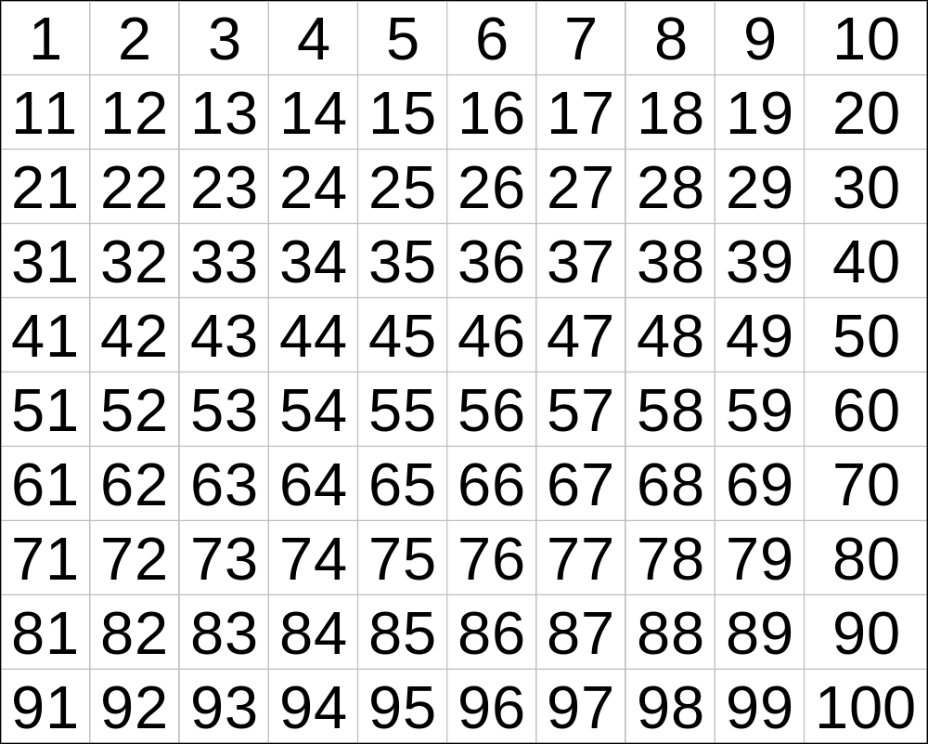
Strike the two’s, strike the three’s the Sieve of Eratosthenes
25 primes
Below 100
when the multiples sublime, the numbers that remain are prime!
Notes:
Slides 5 and 6 give the resource sheets.

Slide 4
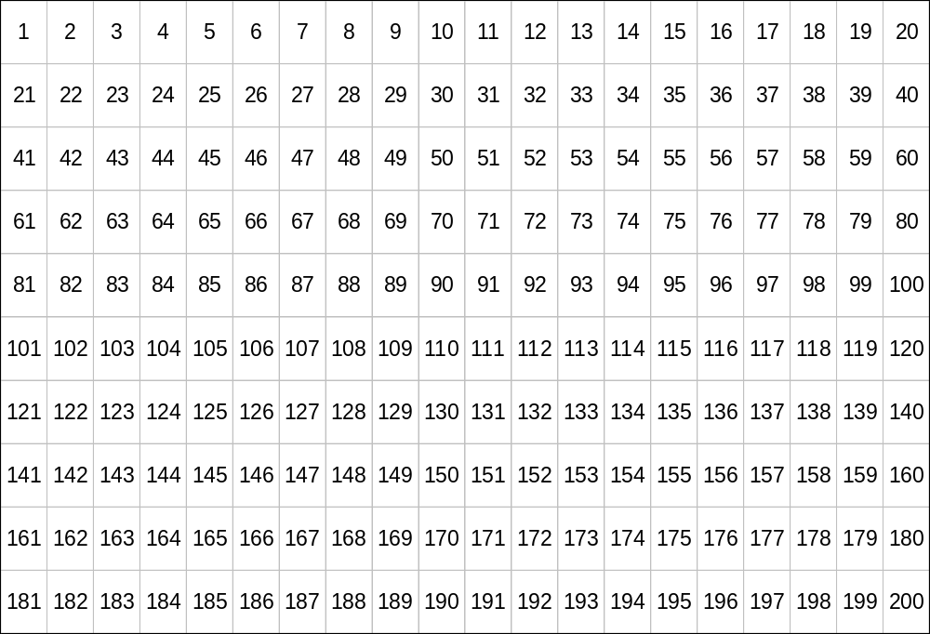
Use the method of Eratosthenes to find all primes below 200
What is the largest prime <√200?
46 primes below 200

Slide 5
Range
Number of Primes
0 – 1000
168
1000 – 2000
135
2000 – 3000
127
3000 – 4000
120
4000 - 5000
119
5000 - 6000
114
6000 - 7000
117
7000 – 8000
107
8000 - 9000
110
9000 – 10 000
112
?
10 000 – 11 000
106
11 000 – 12 000
103

Slide 6
Strike the two’s, strike the three’s the Sieve of Eratosthenes
when the multiples sublime, the numbers that remain are prime!

Slide 7
Strike the two’s, strike the three’s the Sieve of Eratosthenes
when the multiples sublime, the numbers that remain are prime!

